Slide 1
Discrete Math/Structures and The Spread Spectrum by Eric Jorden for cs131
Enhancing connections, communication, and networking between people, places and more.

Slide 2
What is the spread spectrum?
A method of sending/receiving radio signals or wireless waves, spreading around ranging from short, medium, long range that can rapidly change their carrier frequency, and adapt, creating hopping patterns, to be able to "hop” around with modulating or modifying the signal, encoding it, spreading it and create an adaptive secure connection. Previous connections were fixed or one way, could be jammed or intercepted.
Originally developed as the frequency hopping spread spectrum by Hedy Lamarr (inventor/actress) and George Antheil (musician) in 1942, based on radio, originally created to increase security in wireless communication, as a secret communication system and make it more secure, private, like to reduce jamming, hacking and interference. . Also, makes it difficult to interfere with wireless connections like, being hacked, or eavesdropping.
An early example was used by the military, like in world war 2 and other military use to be able to communicate to troops, aircrafts, and with secured radio, and reduce enemy interference, intercepting, and decoding signals
It’s generated by a transmitter and receiver, utilizing a predetermined fixed number of different waves, signals, bands, channels and frequencies. Then the transmitter changes or modulates their pattern or “channel” on the fly depending on the carrier’s frequency, channel and “wavelength”, with the receiver taking in the signals when chosen by the user. It’s also near invisible with the naked eye, so it happens in the background or discretely. Also, it discretely structures a connection or multiple connections with a combination of multiple discrete math/structures like, graph theory, combinatorics, number theory, modular arithmetic, probability theory, algorithms, and data structures, act as building blocks to create it, and make it possible, or function.
Similarly, enables the use of Cordless Phones, Wi-Fi, Bluetooth, Satellite, Cellular Networks and GPS, from changing to nearby faster/reliable, and different frequencies/channels, like Wi-Fi networks, Bluetooth devices, GPS navigation, Satellite communication and more. It’s also able to do it automatically or manually by the user.

Slide 3
Continued: what is the spread spectrum, how it applies to everyone. everything, everywhere and allowed to be used all at once.
Hedy Lamarr and George Antheil created the technology based on based on the concept of how a player piano uses a roll to control the notes being played. They developed a system where the frequencies of transmission could be set and adapted, allowing for the ability to alternate frequencies and create a hopping effect. Allowing a transmitter send out a signal, adapting/encoding it, then a receiver would receive the signal securely
Alternate forms and Improvements include, DSSS, AFH, CDMA and OFDM.
The technology was later used for consumer use, becoming more common to create wireless communication, connection, networking, some examples include Wi-Fi, (Wireless Fidelity). It enables wireless calls, internet connections, smartphones, laptops, tablet, internet of thing devices or connected devices. Also, CDMA (code multiple division access),for cellular networks or GPS, (Global Positioning System) for wireless directions and navigation. How it modulates/modifies the signals to be robust, fast, secure, and able to have multiple devices have access.
Bluetooth for shorter range communication like, Bluetooth file transfer, wireless mouse/keyboard and controllers, wireless “hands free calling, like when driving, walking or not being stationary” and audio.
To differentiate their range, Satellite/GPS = used for Long Range Cellular = used for Long Range Wi-Fi = used for Medium Range Bluetooth = used for Short Range A lot of discrete processing processes in the background, while the user can switch on the fly. Overall allowing less cables, wireless connections, and makes connection/communication more convenient. Thereby, allowing everyone to be connected, safe and able to be wireless worldwide.

Slide 4
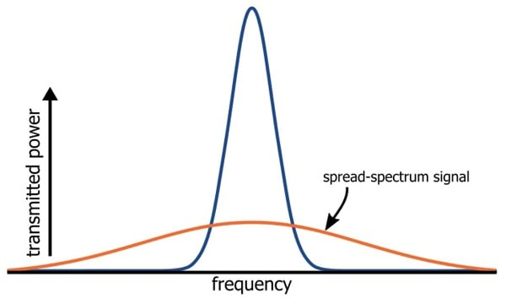
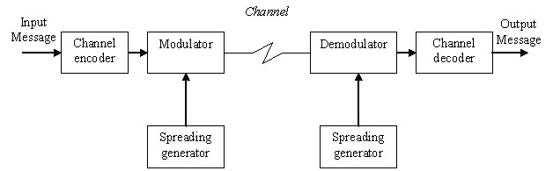
How the Spread Spectrum looks. As it gets transmitted and can vary on the frequency and modulation.

Slide 5
How Discrete math/structures apply to the spread spectrum.
Graph Theory: Graph theory, a branch of discrete mathematics, deals with the study of graphs, which are mathematical structures used to represent relationships between objects. In the context of wireless communication, graph theory can be applied to model the connectivity and network topology of Wi-Fi and Bluetooth networks. Concepts such as vertices (representing devices) and edges (representing connections) can be used to analyze the properties and performance of wireless networks.
Combinatorics: Combinatorics is the branch of discrete mathematics that deals with counting, permutations, and combinations. In frequency hopping spread spectrum, the generation of hopping sequences involves the arrangement and selection of channels. Combinatorial techniques can be used to analyze the number of possible hopping sequences, determine their properties, and ensure efficient coverage of the available frequency channels.
Number Theory and Modular Arithmetic: Number theory is a branch of discrete mathematics that focuses on properties and relationships of integers. Modular arithmetic, a fundamental concept in number theory, is widely used in cryptography and security mechanisms employed in Wi-Fi and Bluetooth. Modulo operations and congruence relationships are applied in encryption algorithms and error detection/correction techniques.
Probability Theory: Probability theory plays a crucial role in analyzing the performance and reliability of wireless communication systems. In Wi-Fi and Bluetooth, understanding the probability of interference, channel capacity, and error rates is essential for designing efficient algorithms and optimizing communication protocols. Concepts like conditional probability, random variables, and Markov chains are applicable in modeling and analyzing wireless communication scenarios.
Algorithms and Data Structures: Discrete mathematics provides the foundation for algorithm design and analysis. Wi-Fi and Bluetooth employ various algorithms for tasks such as frequency hopping, data modulation, error correction, and signal processing. Concepts like data structures (e.g., queues, arrays) and algorithmic techniques (e.g., searching, sorting, graph algorithms) are employed in the efficient implementation of wireless communication protocols.
It's concepts and techniques form the basis for understanding and analyzing the algorithms, protocols, and mathematical principles underlying Wi-Fi, Bluetooth, GPS, Satellite, Cellular networks and the Spread spectrum.

Slide 6
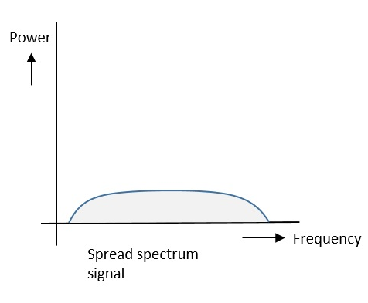
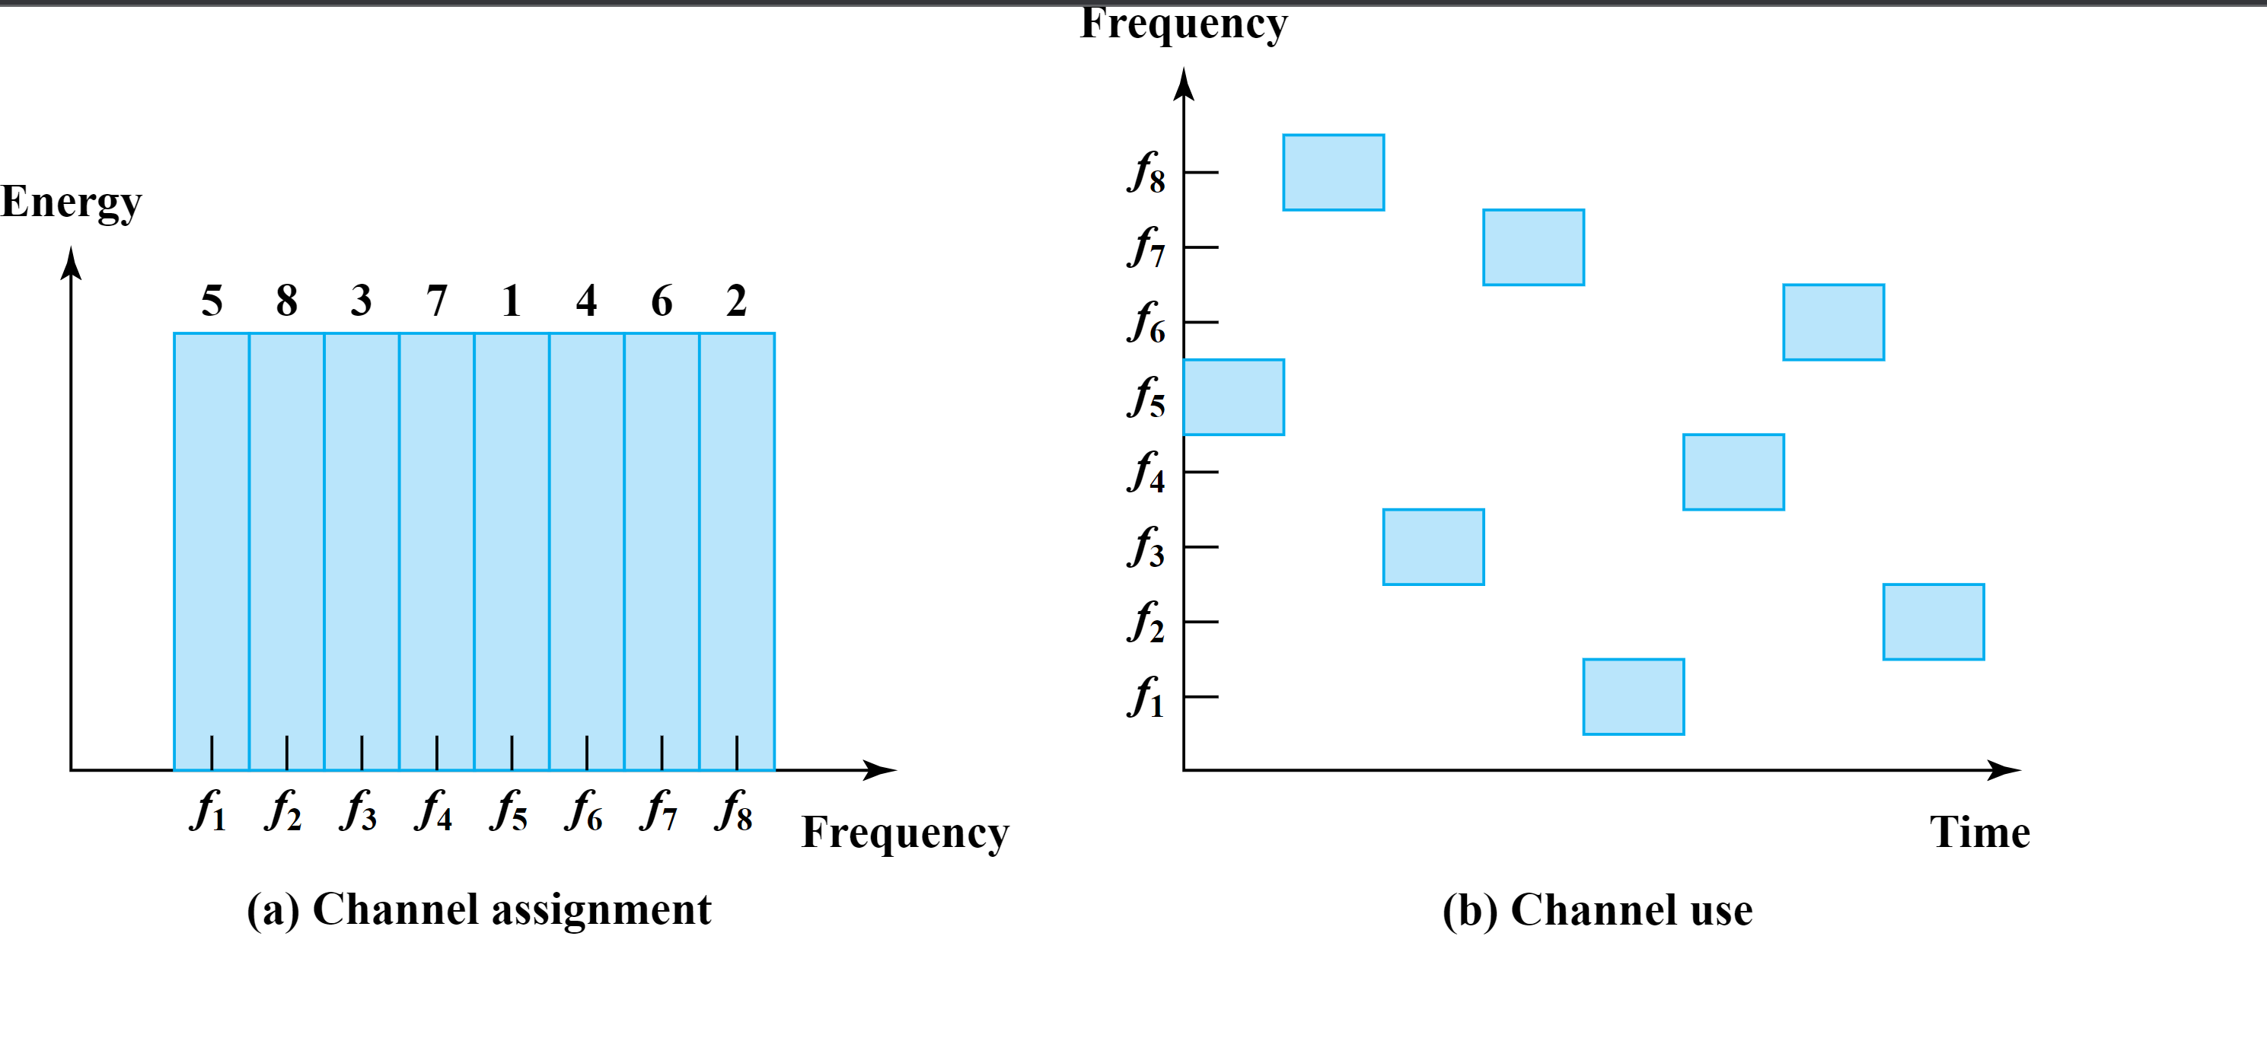
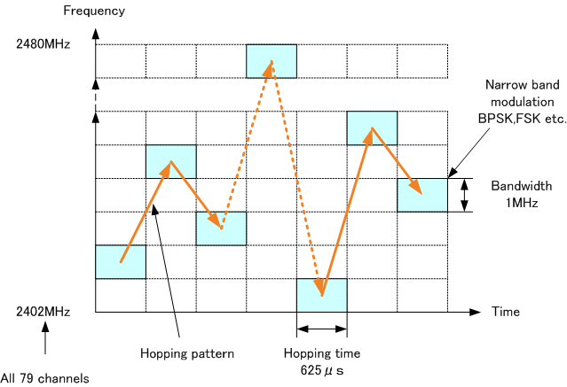
How Frequency Hopping Spread Spectrum looks
Instead of a fixed spread connection (one-way signals), less security. effective The frequency hopping spread spectrum can hop around and modulate, and change frequencies/signals/waves/channels between the transmitter (sender) and receiver. (one way, two way, or multi node) more security. effective

Slide 7
Overview on how it applies to Wi-Fi, and Bluetooth.
Class | Frequency Bands | Wave Lengths Versions
Wi-Fi Frequency Bands | 2.4-5ghz and possibly more. | b/a/g/n/ac/ax/ay/be From 11mbps up to 10gbps
Bluetooth Bands | 2.4-2.48ghz | Versions From 1.0-2.0-3.0-4.0-5.0, and LE
Speeds | Wi-Fi = 11mbps up to 10gbps and possibly more. | Bluetooth 125kbps-2mbps,and possibly more.
The spread spectrum algorithm, is used for Wi-Fi and Bluetooth discretely from sight, (near invisible), advancements made over time with DSS, OFDM, and AFH. Signals can hop around and change/modulate based on the user choice manually or automatic.
Wi-Fi was created by by Dr. Vic Hayes (Also, inventor/scientist, considered to be “father of Wi-Fi”) Also, helped create the Institute of Electrical and Electronics Engineers (IEEE) for future Wi-Fi development, improvements. Bluetooth was invented by Dr. Jaap Haartsen, an Ericsson engineer and his team. Later, Including the Bluetooth Special Interest Group. Also theorized by Jim Kardach. (Inventor/Scientist) Bluetooth was later improved to use less energy, (Low Energy) to be more power efficient.
All use a similar concept of transmitter and receiver to send/receive data. changing frequencies and modulating. Other wavelengths/bands/frequency that are used are Original Wi-Fi 802.11b = FHSS Improved Modulation, Speeds, Frequencies Range, and Security. Improved 802.11b/g/n/ = DSSS Additional Improvement 802.11b/a/g/n/ac/ax/ay/be. = OFDM For longer/faster speeds. It can range from 2.4-5ghz and 6ghz (Wi-Fi 1,2,3,4,5 and Wi-Fi 6), and in future improvements, Wi-Fi 7, and beyond. 2.4ghz supports 14 channels and can be 5-20mhz. 5ghz supports 36-165 channels and can be 20-160mhz (a = 5ghz Wi-Fi). More Improvements can be possible over time, like faster or different like 6ghz and more.
Wi-Fi devices can choose different frequencies or networks to connect to, and routers choosing the best channel or frequency for a better

Slide 8

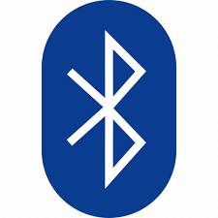
Continued overview of Wi-Fi and Bluetooth
Groups created/dedicated to both were created to further improve and aid in development. Wi-Fi Alliance and, Bluetooth Special Interest Group.
Wi-Fi is used for medium range, signal degrades when further away, good for homes, offices, café’s, libraries. (can get spotty or slower the further away).
Bluetooth is used for short range, file transfer between devices next to each other, audio, hands free calling. So, it can also get spotty or slower, the further away.
Both are under the IEEE Institute of Electrical and Electronics Engineers (IEEE). Wi-Fi is under 802.11. Bluetooth is under 802.15.1. Both are different enough to avoid interference from each other and coexist.

Slide 9
Advantages and Disadvantages of the spread spectrum
Advantages of Spread Spectrum:
Resistance to Interference: Spread spectrum techniques can spread the signal over a wider bandwidth, making it more resistant to narrowband interference and improving overall reliability.
Security: Spread spectrum also provides a level of security by spreading the signal using a pseudorandom sequence or code, making it difficult for unauthorized parties to intercept or interfere with the communication.
Coexistence: Spread spectrum allows multiple systems to coexist in the same frequency band without significant interference, enabling efficient spectrum utilization and supporting multiple users or devices simultaneously.
Robustness: Spread spectrum techniques are robust against various sources of interference, like, multipath fading, frequency-selective fading, and other forms of signal degradation, ensuring reliable communication even in challenging environments.
Disadvantages of Spread Spectrum:
Increased Bandwidth Requirements: Spread spectrum techniques typically require a wider bandwidth compared to other modulation techniques, which can limit their suitability in applications with limited bandwidth availability
Complexity: Implementing spread spectrum systems can involve additional complexity in terms of signal processing, synchronization, and code generation. This complexity can impact system design, implementation, and resource requirements.
Lower Spectral Efficiency: Spread spectrum techniques may have lower spectral efficiency compared to other modulation techniques, as they spread the signal energy over a wider bandwidth. This can affect the overall data rate, speed or capacity, range of the system.
Also, depending the spectrum used, it can have its advantages and disadvantages as well.

Slide 10
Variations/Improvements/ and Alternate Forms of The Spread Spectrum
Similarities And Differences

Slide 11
Advancements and Variations of the Frequency Hopping Spread Spectrum with Multiplexing
Advancements and variations include DSSS, OFDM, AFH,CDMA, and multiplexing.
Multiplexing, used to improve the efficiency and range and alternate form, so both can be used for wireless efficiency and improvements.
Multiplexing is a technique for sending multiple signals over a single channel. This can be possible by dividing the channel into different frequency bands, time slots, or code sequences. Multiplexing is used in a wide variety of applications, including telecommunications, computer networking, and radar. Also, has various forms.
Frequency-division multiplexing (FDM) divides the channel into different frequency bands. This is used in telecommunications to send multiple voice signals over a single cable.
Time-division multiplexing (TDM) divides the channel into different time slots. This is used in computer networking to send multiple data streams over a single network link.
Code-division multiple access (CDMA) divides the channel into different code sequences. This is used in wireless communications to send multiple signals over a single radio frequency.
Named as Direct Sequence Spread Spectrum, Orthogonal Frequency Division Multiplexing, Adaptive Frequency Hopping, and Code Division Multi Access.
All are based on the spread spectrum and modulation overall and enables many ways to create wireless connections among everyone worldwide.

Slide 12
Alternate forms, Improved Advancements and Variations
Direct Sequence Spread Spectrum (DSSS): Created by Gustav Guanella,(inventor) with information and groundwork from Claude Shannon, (computer scientist/engineer/inventor) The idea was proposed to be an alternate form of a secret communication system like FHSS. DSSS is an advancement of FHSS. It is a spread spectrum technique that spreads the signal over a wider bandwidth using a spreading code. Unlike FHSS, which hops between different frequencies, DSSS spreads the signal across a wide frequency range, providing increased resistance to interference and improved reliability.
Example: "DSSS, as an advancement of FHSS, employs a spreading code to spread the signal across a wider bandwidth, enhancing resistance to interference.“ Used to improve Wi-Fi, Satellite, and Cellular improvements
Orthogonal Frequency Division Multiplexing (OFDM): Created by Robert W Chang, (engineer) Weinstein, (engineer) Ebert (engineer) and Bell Labs. OFDM is a development derived from FHSS. It is a modulation technique that divides the available bandwidth into multiple subcarriers, each carrying a smaller portion of the data. By using orthogonal subcarriers, OFDM provides higher spectral efficiency and mitigates the impact of multipath interference. Also used for Wi-Fi, Satellite, and Cellular improvements
Example: "OFDM, an evolution of FHSS, divides the available bandwidth into orthogonal subcarriers, enabling higher data rates and improved resistance to multipath interference."
Adaptive Frequency Hopping (AFH): Created by Robert A. Scholtz (engineer/researcher) and the Bluetooth Special Interest Group, AFH can be considered an enhancement of FHSS. It stands for Adaptive Frequency Hopping and is utilized in Bluetooth technology. AFH dynamically selects and avoids congested or noisy frequency channels, providing improved coexistence with other devices and minimizing interference. Used to improve Bluetooth.
Example : "AFH, an advancement built upon FHSS, intelligently adapts the frequency hopping pattern by avoiding congested channels, leading to enhanced coexistence and reduced interference."
These statements highlight upon how DSSS, OFDM, and AFH have evolved from or built upon the principles of FHSS, also under the spread spectrum incorporating advancements to improve various aspects of spreading, hopping, reliable, efficient secure wireless communication and connections. Also, while these methods were created and theorized by these engineers, inventors, scientists, and organizations. It has also had various collective contributions from many and multiple researcher and organizations too. That further increased its creation and advancements over time.

Slide 13
How the spread spectrums add to cellular networks
Code Division Multiple Access (CDMA): CDMA is based on spread spectrum technology, specifically the Direct Sequence Spread Spectrum (DSSS). It uses unique spreading codes to differentiate multiple users and enable simultaneous transmission over the same frequency band. Also used for earlier means of wireless telecommunication, like, 1x,2g,3g. (g stands for generation and x stands for radio transmission technology) Developed by Qualcomm
Long Term Evolution (LTE): LTE is a 4G technology based on the Orthogonal Frequency Division Multiplexing (OFDM) for the downlink and Single Carrier Frequency Division Multiple Access (SC-FDMA) for the uplink. While OFDM is a form of spread spectrum, LTE incorporates OFDM with other advanced techniques like MIMO (Multiple Input Multiple Output) and advanced coding schemes. Developed by the group, 3rd Generation Partnership Project (3GPP)
Fifth Generation (5G): 5G is a next-generation cellular technology that utilizes various advanced techniques, including Orthogonal Frequency Division Multiplexing (OFDM) in the downlink and Single Carrier Frequency Division Multiple Access (SC-FDMA) in the uplink, like LTE. While it incorporates aspects of spread spectrum through OFDM, 5G also incorporates other technologies like massive MIMO, beamforming, and advanced network architectures. Developed by the group 3rd Generation Partnership Project (3GPP) and International Telecommunication Union (ITU), and numerous companies also contributed as well and more.
These apply to allow cell towers to send out wireless signals that can send and receive data, like for phones, smartphones, tablets, hotspots. The companies that use these methods are called carriers or known as AT&T, Verizon, T-Mobile, Sprint.

Slide 14
Advantages and Disadvantages
Advantages of DSSS:
Increased resistance to interference: DSSS spreads the signal over A wider bandwidth, then providing increased resistance to interference and improved reliability.
Higher data rates: DSSS allows for higher data rates compared to FHSS. Simplicity: DSSS implementation is generally simpler compared to FHSS, as it doesn't require sophisticated hopping mechanisms.
Disadvantages of DSSS:
Vulnerability to interference: while DSSS offers increased resistance to interference, it can be still susceptible to interference within the spread bandwidth.
Lower spectral efficiency: DSSS requires a wider bandwidth compared to other modulation techniques, resulting in lower spectral efficiency.
Advantages of OFDM:
Improves upon FDM or Frequency Division Multiplexing, by allowing multiple subcarriers to carry data, while being independent, (so no interference occurs)
High spectral efficiency: OFDM divides the available bandwidth into multiple orthogonal subcarriers, enabling higher spectral efficiency and able to accommodate multiple data streams simultaneously.
Resistance to multipath interference: OFDM's use of orthogonal subcarriers helps mitigate the impact of multipath interference, making it more suitable for high-capacity and reliable communication.
Flexible allocation of subcarriers: OFDM allows for adaptive allocation of subcarriers, optimizing the system performance based on channel conditions.
Disadvantages of OFDM:
Sensitivity to frequency offset and timing errors: OFDM systems can be sensitive to frequency offset and timing errors, thereby requiring careful synchronization. High peak-to-average power ratio: OFDM signals can exhibit A high peak-to-average power ratio, which can result in power inefficiency and potential nonlinear distortion which may impact system or performance.

Slide 15
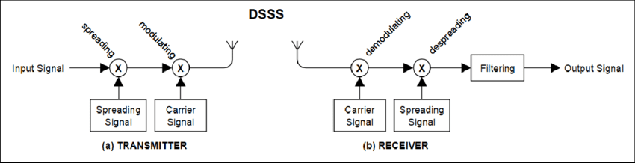
How DSSS, looks like.
DSSS, looks like FHSS, similar transmitter, modulating and receiver concept. and can be considered an alternative.

Slide 16
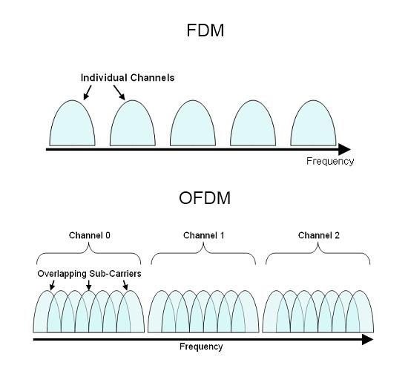
How OFDM looks like, with multiple subcarriers carrying data.

Slide 17
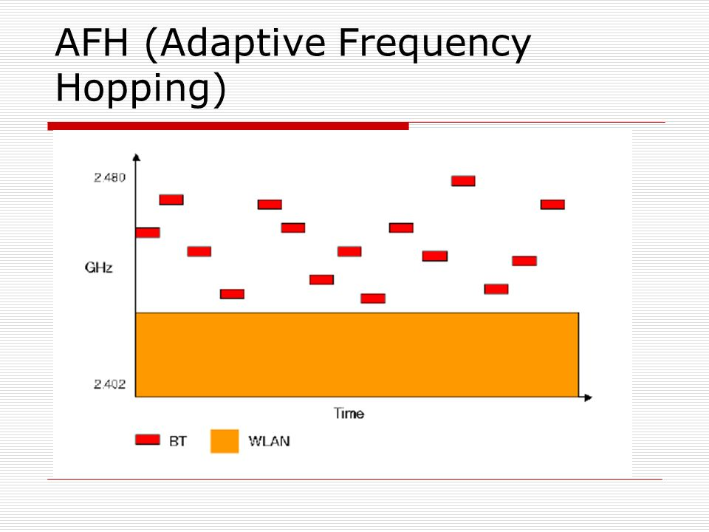
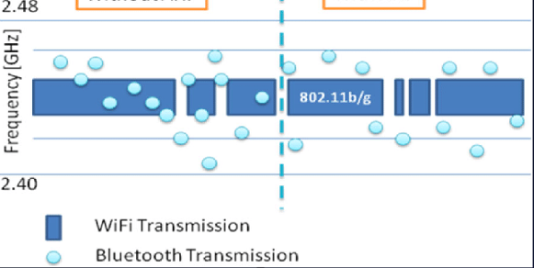
How AFH looks like
With AFH
Without AFH

Slide 18
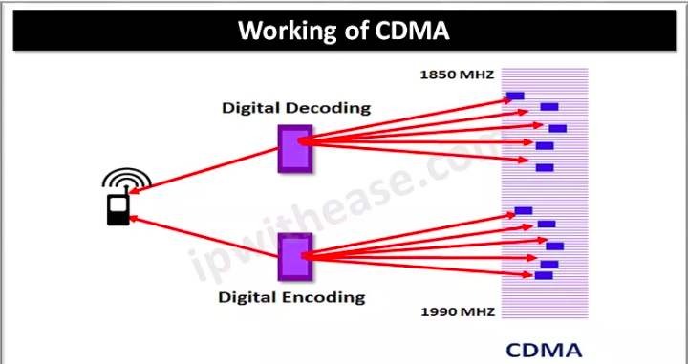
How CDMA looks like

Slide 19
Continued Advantages and Disadvantages.
Advantages of AFH:
Improved Coexistence: AFH dynamically selects and avoids congested or noisy frequency channels, providing improved coexistence with other devices and minimizing interference.
Adaptive and Dynamic: AFH can adapt its frequency hopping pattern based on the changing environment, allowing for optimal performance in different conditions.
Disadvantages of AFH:
Limited Applicability: AFH is primarily utilized in Bluetooth technology and may have limited relevance outside of Bluetooth applications.
Complexity: Implementing AFH requires additional complexity in terms of monitoring and selecting frequency channels dynamically, which can increase system complexity and resource requirements.
These advantages and disadvantages highlight upon the key characteristics and considerations of FHSS, DSSS, OFDM, and AFH, aiding in understanding their suitability and trade-offs in different wireless communication scenarios.

Slide 20
Conclusion
Overall, the spread spectrum and discrete math/structures allows our world to be connected more through breakthrough wireless communication and connections. A lot of discrete processing and communication of wired to wireless signals happen in the background. Yet, simplified to the users and allowing everyone and everything to be connected. Also, as newer technologies are improved or created, it will further advance our digital, wireless interconnected world worldwide.

Slide 21
References and bibliography.
http://mathworld.wolfram.com/GraphTheory.html
https://brilliant.org/wiki/graph-theory/
https://mathworld.wolfram.com/Combinatorics.html
https://brilliant.org/wiki/combinatorics/
http://mathworld.wolfram.com/NumberTheory.html
https://brilliant.org/wiki/modular-arithmetic/
http://mathworld.wolfram.com/ProbabilityTheory.html
https://brilliant.org/wiki/probability/
https://brilliant.org/wiki/algorithms/
https://brilliant/wiki/data-structures/
https://www.researchgate.net/figure/Adaptive-Frequency-Hopping-AFH_fig4_320339729
https://www.researchgate.net/figure/Block-diagram-of-the-a-transmitter-and-b-receiver-of-the-DSSS-system_fig2_329286286
https://www.design-reuse.com/articles/5715/adaptive-frequency-hopping-for-reduced-interference-between-bluetooth-and-wireless-lan.html
https://en.wikipedia.org/wiki/Frequency-hopping_spread_spectrum

Slide 22
References and Bibliography
https://en.wikipedia.org/wiki/Hedy_Lamarr
https://en.wikipedia.org/wiki/George_Antheil
https://ipwithease.com/what-is-cdma-mobile-technology/
https://devopedia.org/orthogonal-frequency-division-multiplexing
https://en.wikipedia.org/wiki/Wi-Fi
https://en.wikipedia.org/wiki/Bluetooth
https://en.wikipedia.org/wiki/3GPP
https://en.wikipedia.org/wiki/Orthogonal_frequency-division_multiplexing
https://en.wikipedia.org/wiki/Multiplexing
Discrete Mathematics and It’s Applications Eight Edition by Kenneth H. Rosen book.

